Slide 1
Building a Free AppSec Pipeline
@stevemyrick

Slide 2
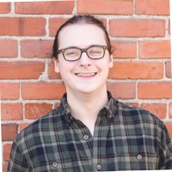
whoami
Manager of Adversarial Engineering & DevSecOps @ Avalara
Offensive security professional for ~7 years
Organizer for EverSec CTF
Triangle-area native

Slide 3
Which of these are AppSec tools and which are Pokemon?
Coverty
Netsparker
Octillery
Probely
Restler
Emolga
Torkoal
Falco
Trivy

Slide 4



Which of these are AppSec tools and which are Pokemon?
Coverty
Netsparker
Octillery
Probely
Restler
Emolga
Torkoal
Falco
Trivy

Slide 5
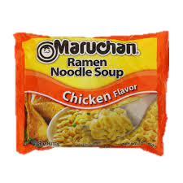

What is this talk about?
Examples of open-source AppSec tooling
Suggestions on automating your smaller projects
Saving money
Efficiency

Slide 6


What is it not?
An exhaustive list of all available tooling
Suggestions for enterprise-grade consumers
Coverage for every language you may be coding in

Slide 7
“Businesses can expect to pay in the range of US$5,000 to US$10,000 on average, per application, per year”
- Contrast Security
Notes:
https://www.contrastsecurity.com/hubfs/docs/WPCostAdvantage121916.pdf

Slide 8
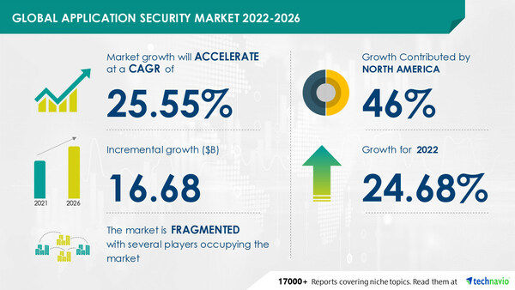
Application Security Market Share
Application Security Market is predicted to hit 26-33 billion dollars by 2030
Expected compound annual growth rate (CAGR) of 15-25%
Notes:
https://www.alliedmarketresearch.com/application-security-market-A10348
https://www.prnewswire.com/news-releases/application-security-market-size-to-grow-by-25-55-application-software-market-to-be-parent-market--technavio-301640639.html

Slide 9
Application Security is expensive but it doesn’t have to be

Slide 10
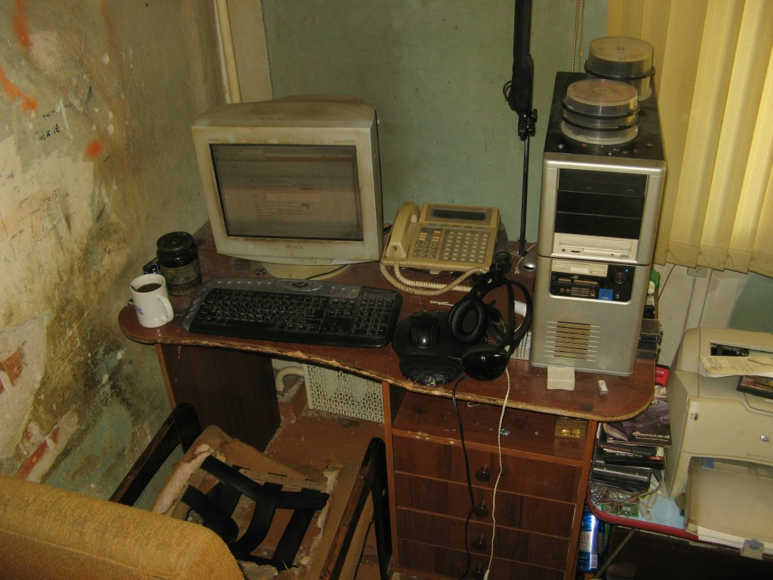
Assumption
We are a single developer
We’re developing an open-source project
We’re developing using popular* languages
Our code is stored in Github
We have no money

Slide 11
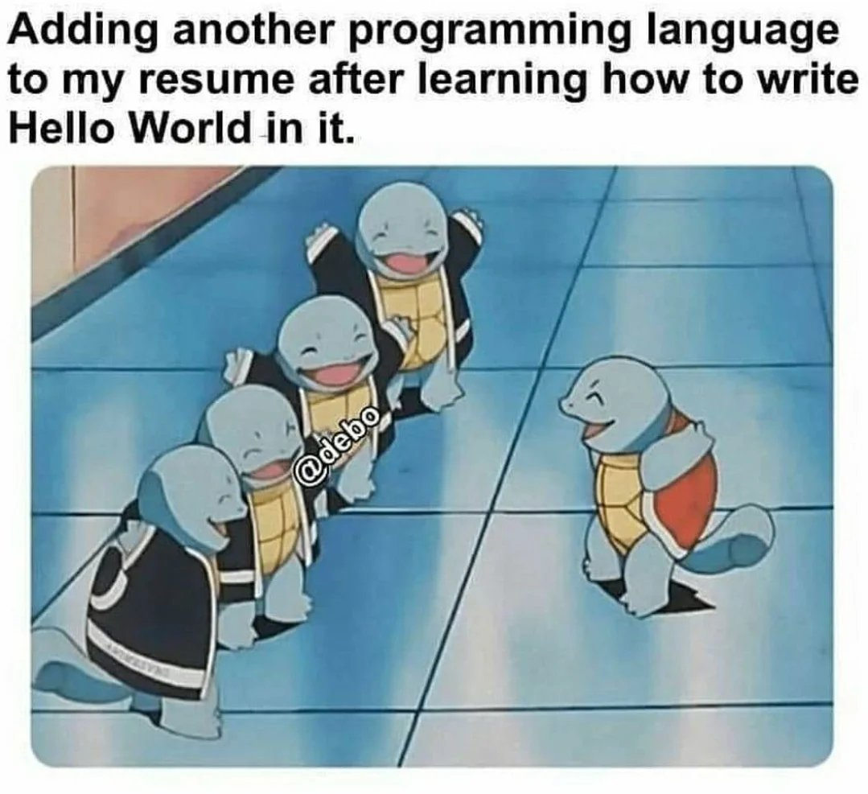
*Top 5 Programming Languages (by developer communities)
Javascript (12.4 mil)
Python (9mil)
Java (8.2 mil)
C++ (6.3 mil)
PHP (6.1 mil)
Notes:
https://www.analyticsinsight.net/top-10-programming-languages-in-2023-with-the-largest-developer-communities/

Slide 12


What Comprises An AppSec Pipeline
Threat Modeling
SAST – Static Application Security Testing
DAST – Dynamic Application Security Testing
SCA – Software Composition Analysis
Secrets Detection
Vulnerability Management

Slide 13
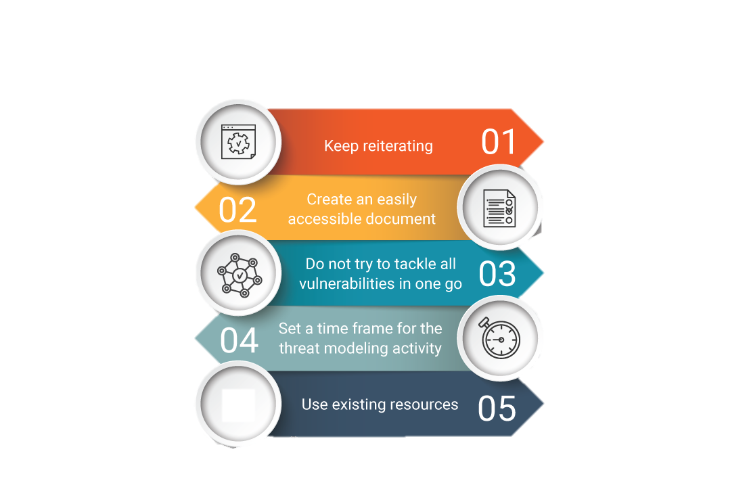
Why Threat Model?
Full view of application infrastructure
Cheaper to fix prior to implementation
Where to focus attention
”Just enough security”
Threat Modeling Best Practices
-Spiceworks
Notes:
https://www.spiceworks.com/it-security/network-security/articles/what-is-threat-modeling-definition-process-examples-and-best-practices/

Slide 14
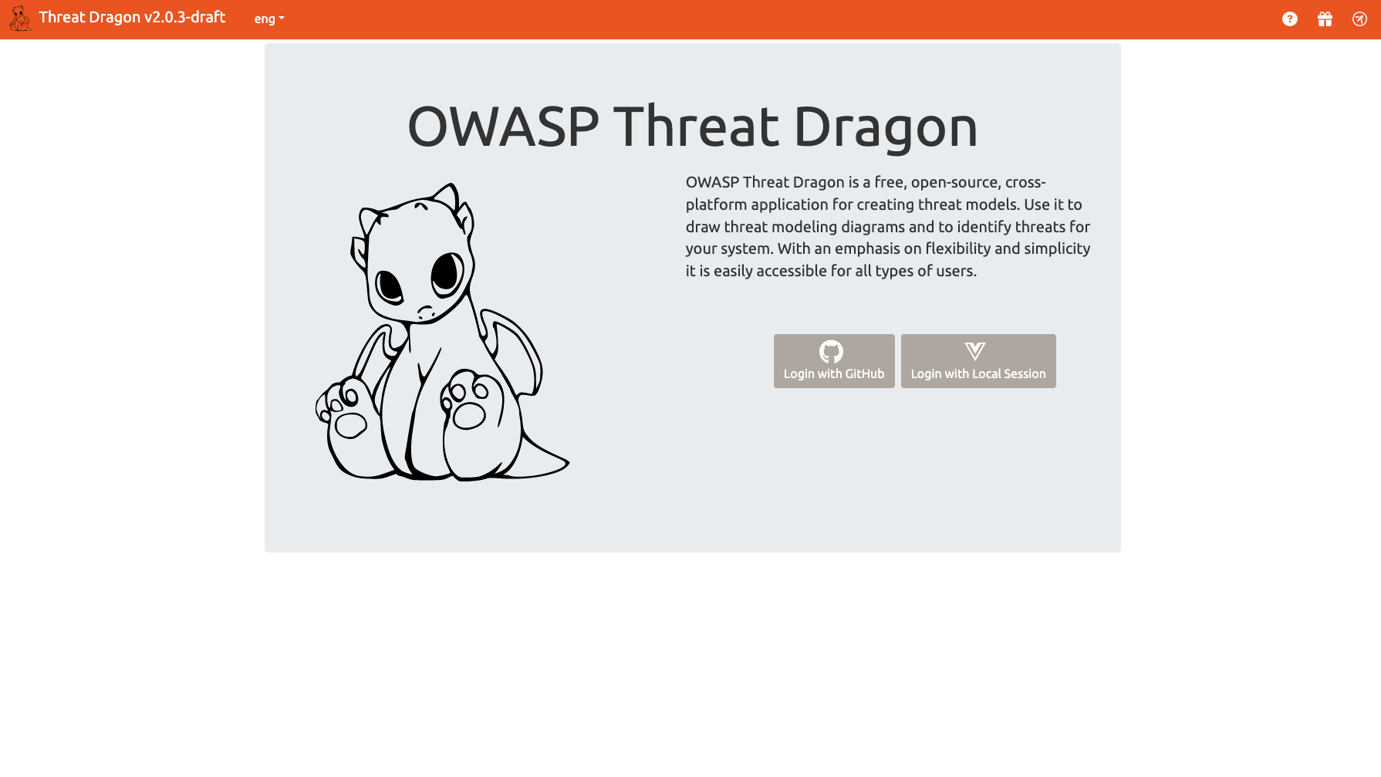
Notes:
https://www.threatdragon.com/#/demo/select
https://owasp.org/www-project-threat-dragon/

Slide 15
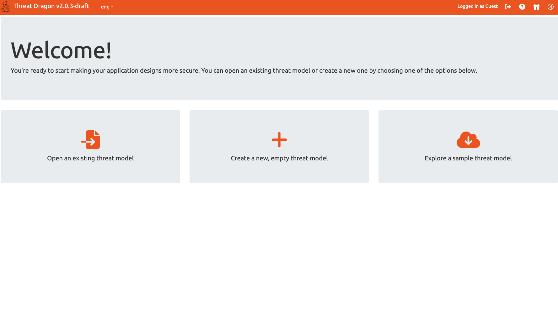

Slide 16
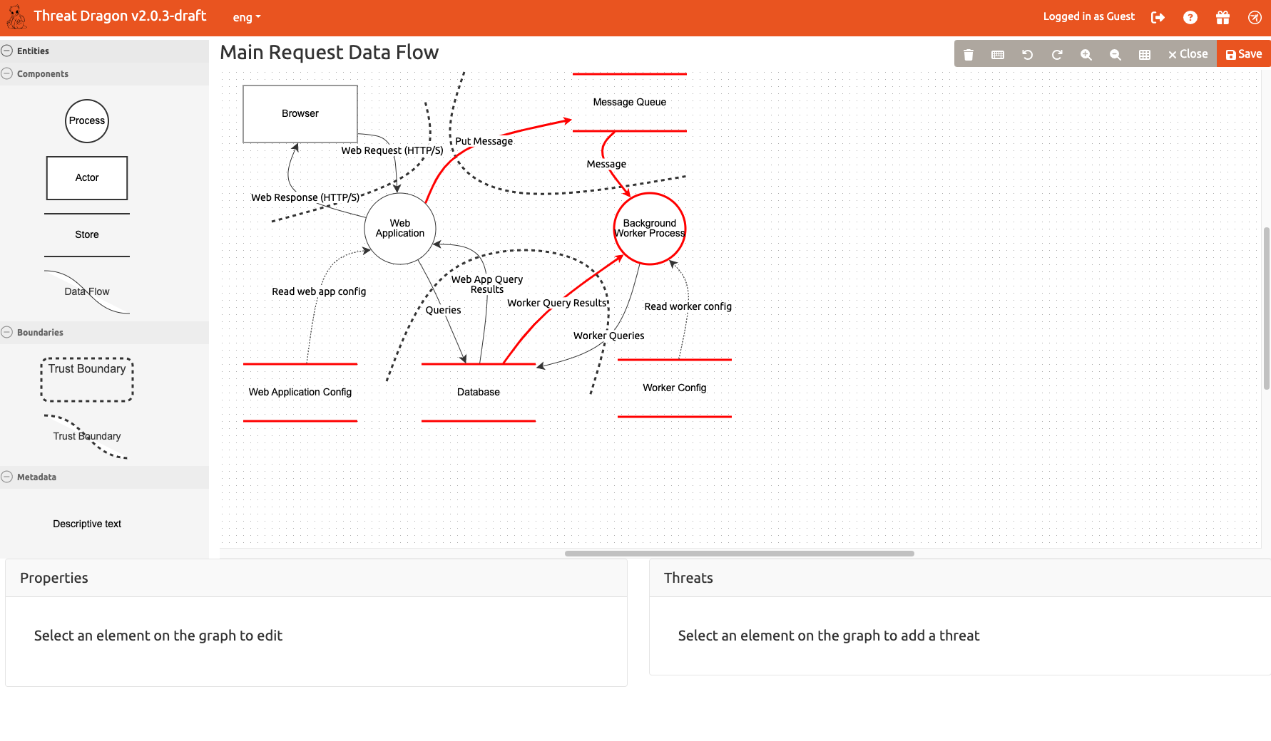

Slide 17
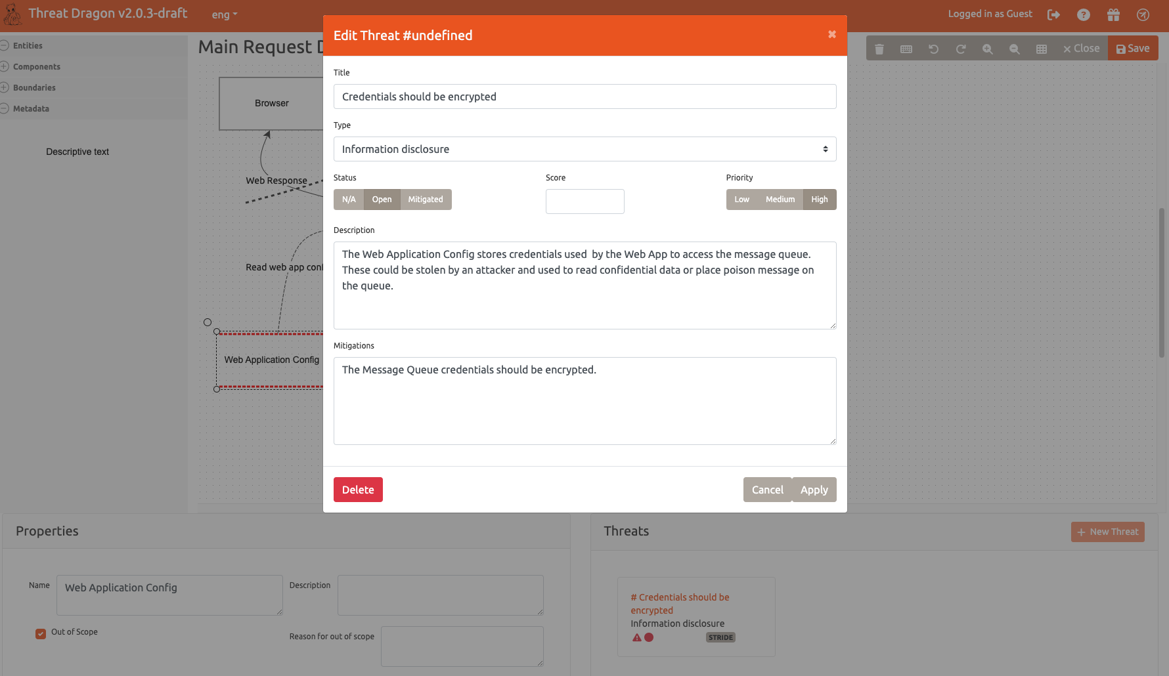

Slide 18

Getting the Most Out Of Github
Dependabot (SCA)
Code Scanning (SAST)
Secret Scanning
Dependency Graphs

Slide 19

Why SCA?
Prevent supply chain attacks
Understand your dependencies
Set up auto-remediation

Slide 20

Dependabot
Identifies vulnerable dependencies
Can open pull requests automatically to resolve alerts
Helps identify supply-chain risk
Notes:
https://github.com/dependabot

Slide 21
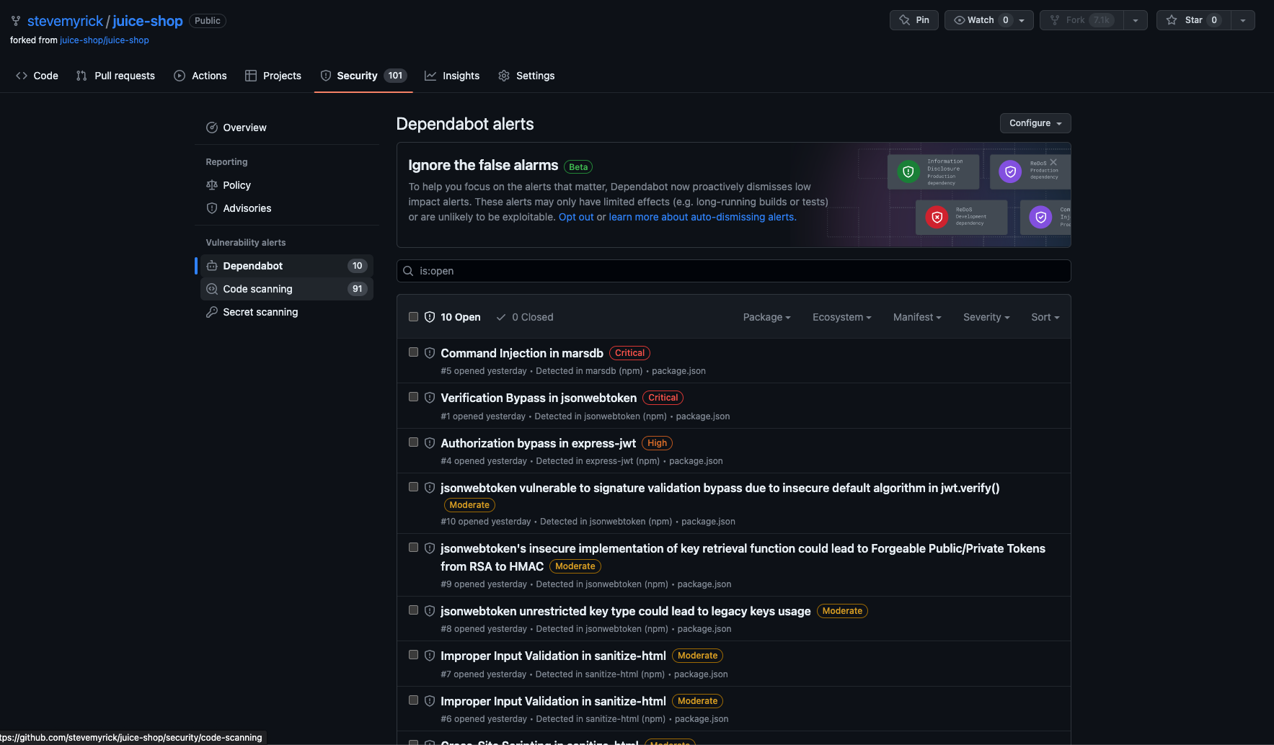

Slide 22
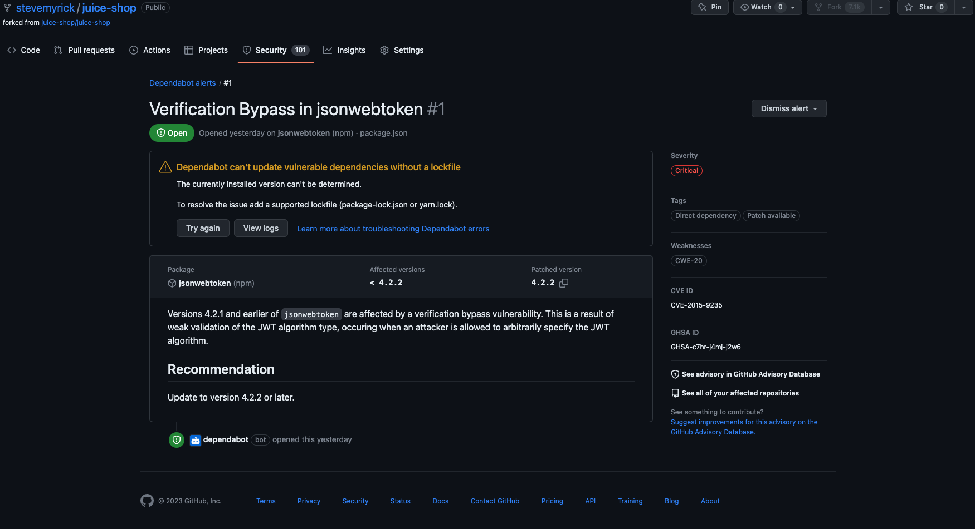

Slide 23
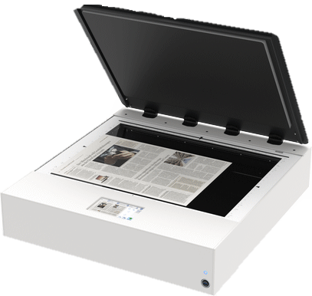
Code Scanning
Free for public repos
CodeQL by default
Supports third-party scanning tools
Import third-party results (SARIF)
Kick off webhook event
Outputs SARIF (Static Analysis Results Interchange Format) data
Notes:
https://docs.github.com/en/code-security/code-scanning/automatically-scanning-your-code-for-vulnerabilities-and-errors/about-code-scanning

Slide 24
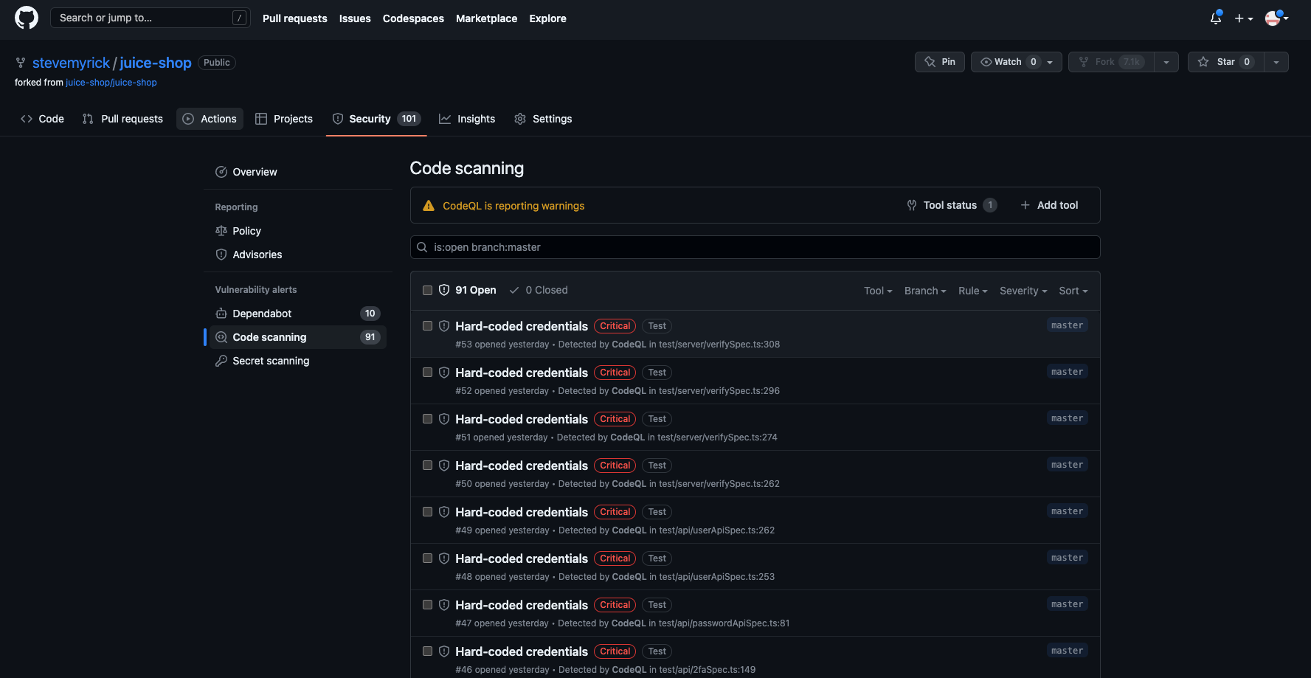

Slide 25
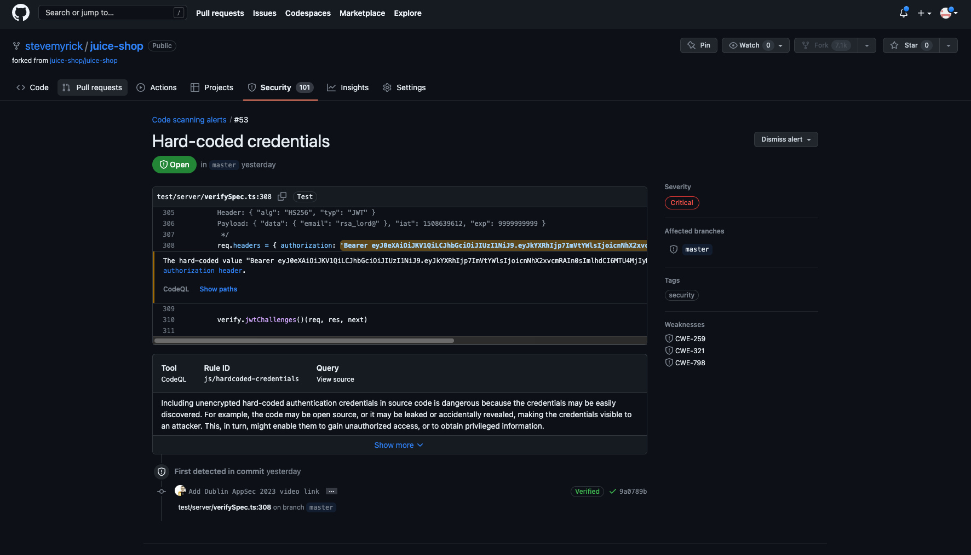

Slide 26
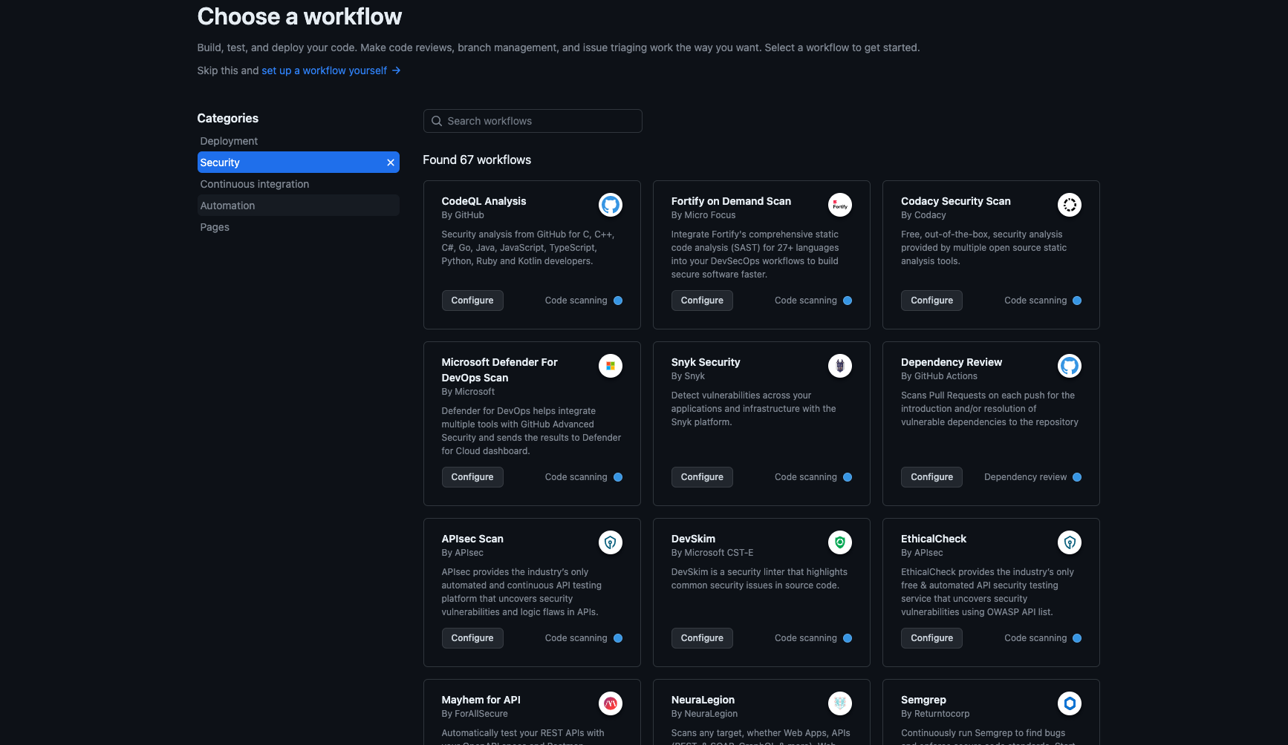

Slide 27
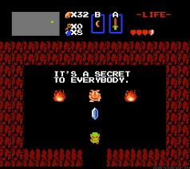
Secrets Scanning
Finds committed secrets (API tokens, etc)
Automatically supports certain partner patterns
Notes:
https://docs.github.com/en/code-security/secret-scanning/about-secret-scanning

Slide 28
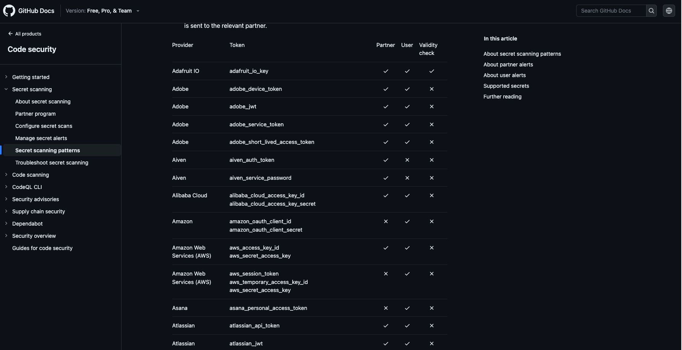

Slide 29
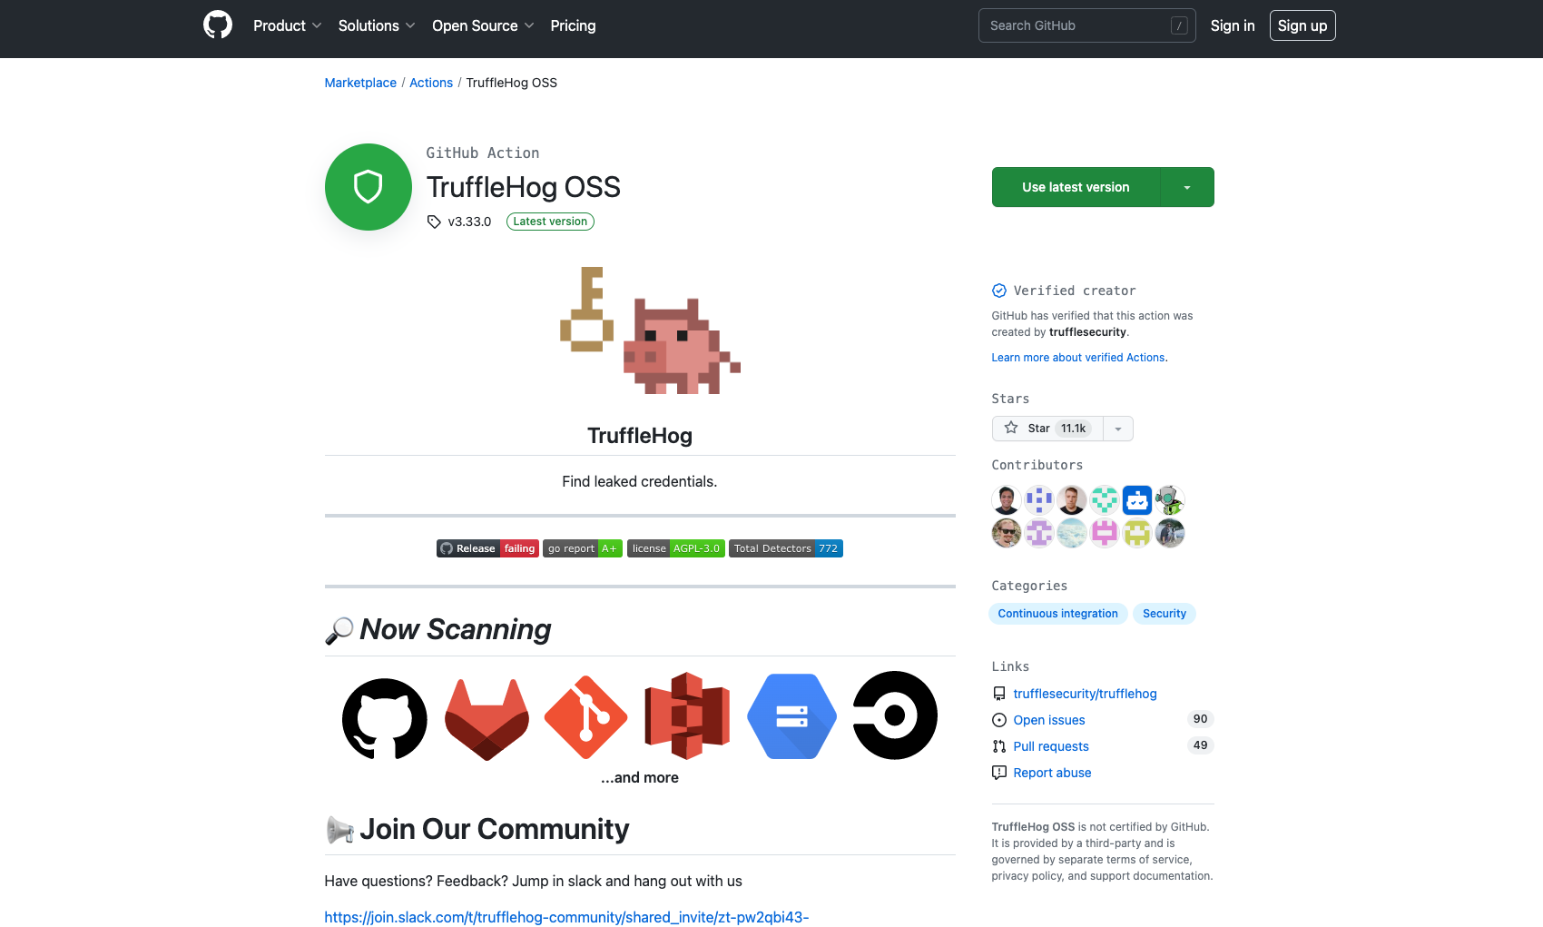
Notes:
https://github.com/marketplace/actions/trufflehog-oss
Mention regex

Slide 30
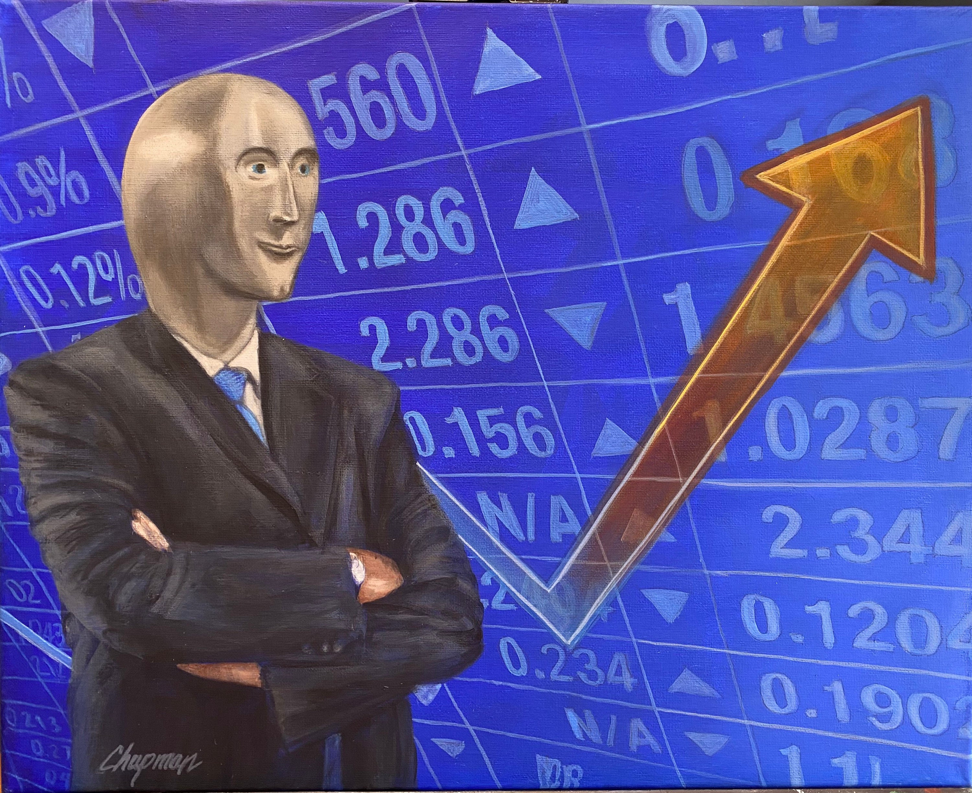
Dependency Graphs
Identifies dependent libraries
Supports direct and indirect (transitive) dependencies
Can export an SBOM (software bill of materials) in SPDX format

Slide 31
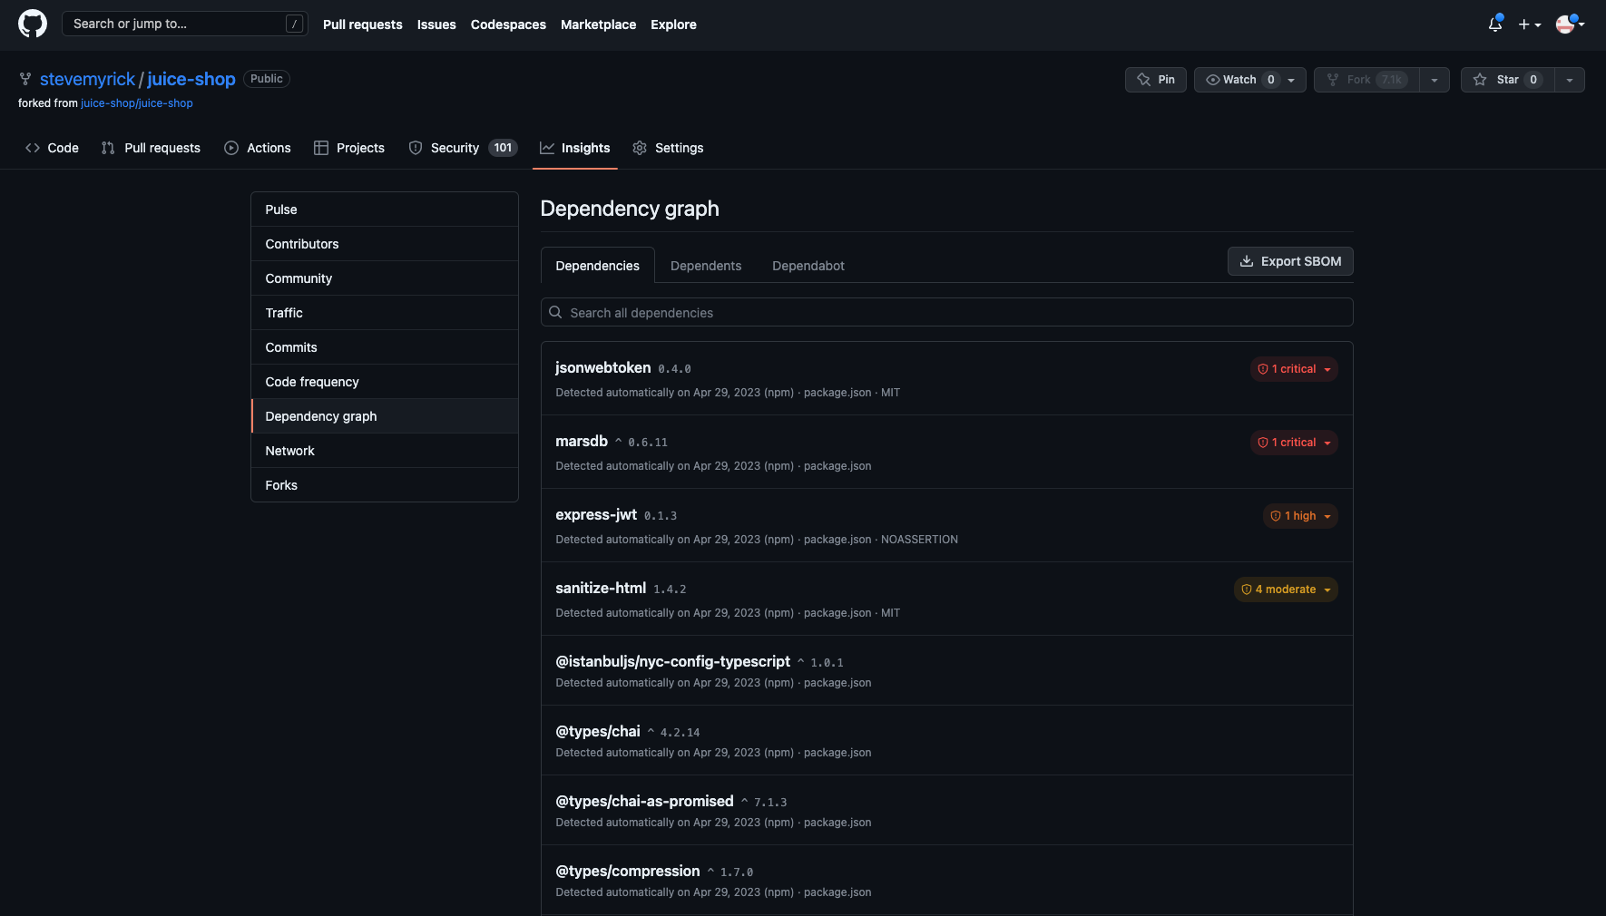

Slide 32
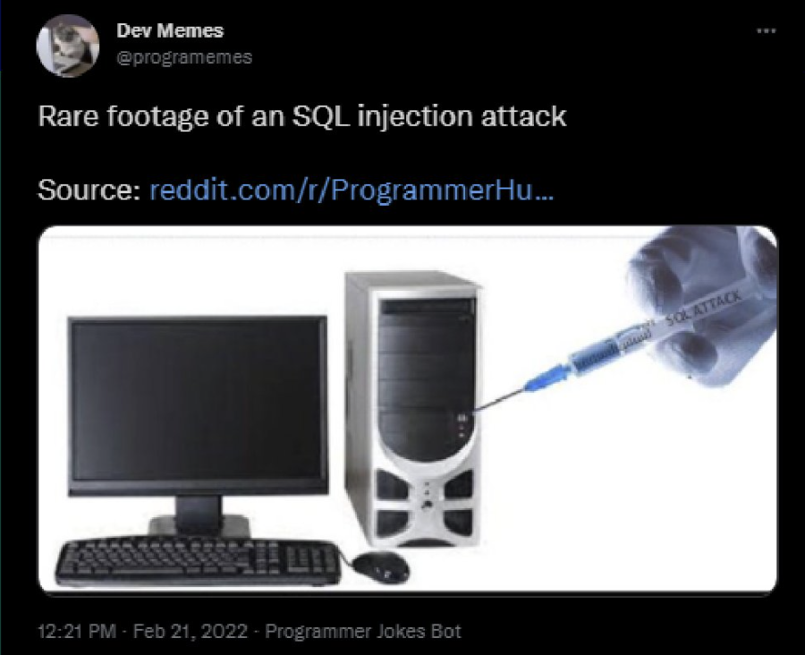
Why DAST?
Find problems easily, catch CVEs
Proactive effort
Low false positives
Work in to build pipeline
Emulate public scanning

Slide 33
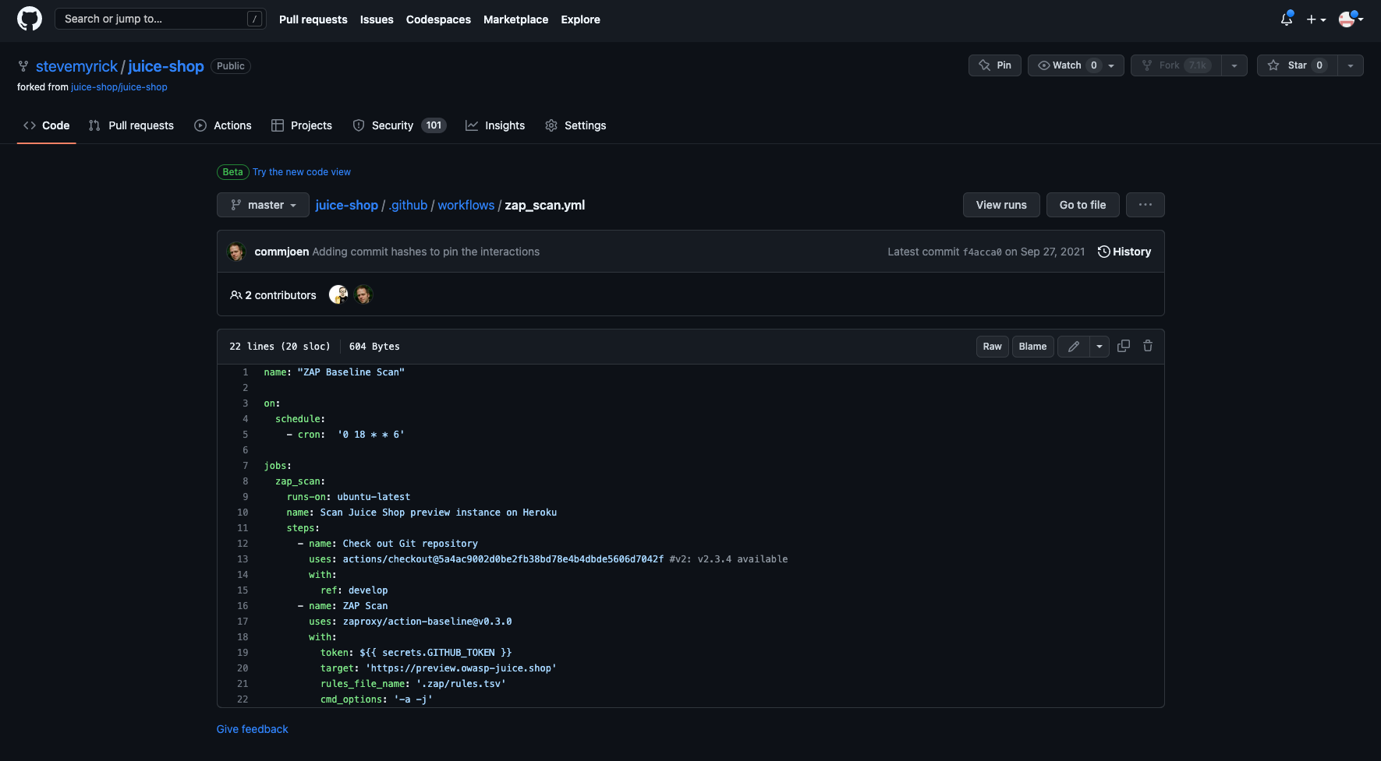

Slide 34
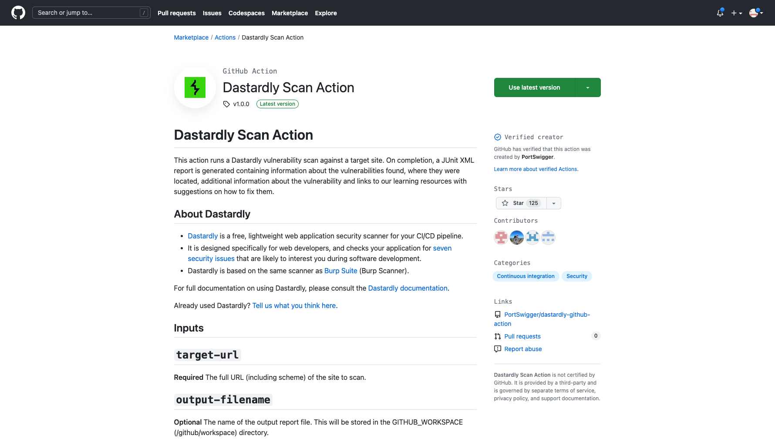
Notes:
https://github.com/PortSwigger/dastardly-github-action

Slide 35

Hosting
DAST requires hosted application
GCP offers 1 free e2-micro VM per month
AWS offers 750 hours of t2.micro
Or host locally

Slide 36
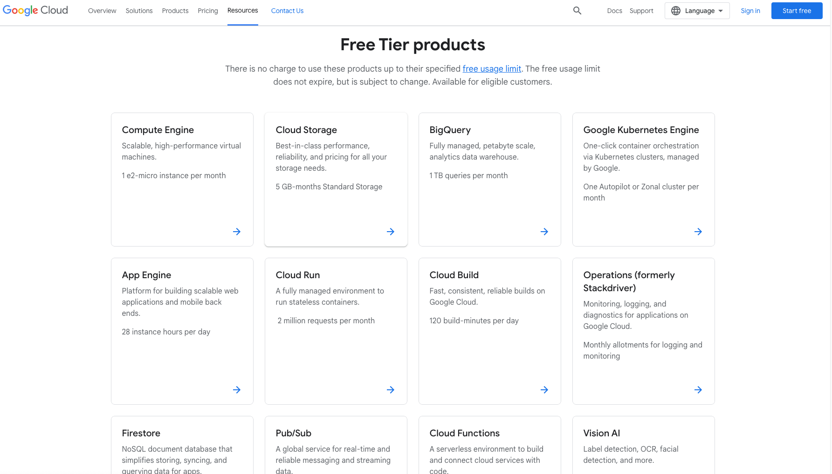
Notes:
https://cloud.google.com/free

Slide 37
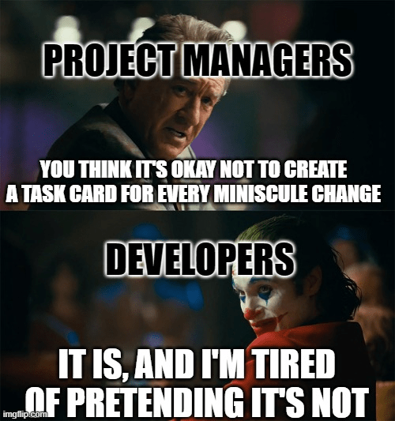
Why Vulnerability Management
Pretty graphs
Show trendlines
Integrate in to ticket management systems
Jira can be free
Prioritize based on risk
Notes:
https://www.atlassian.com/software/jira/free

Slide 38
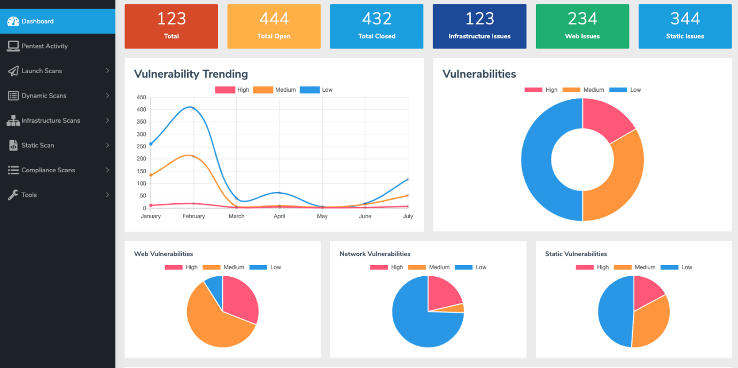
Notes:
https://www.archerysec.com/

Slide 39
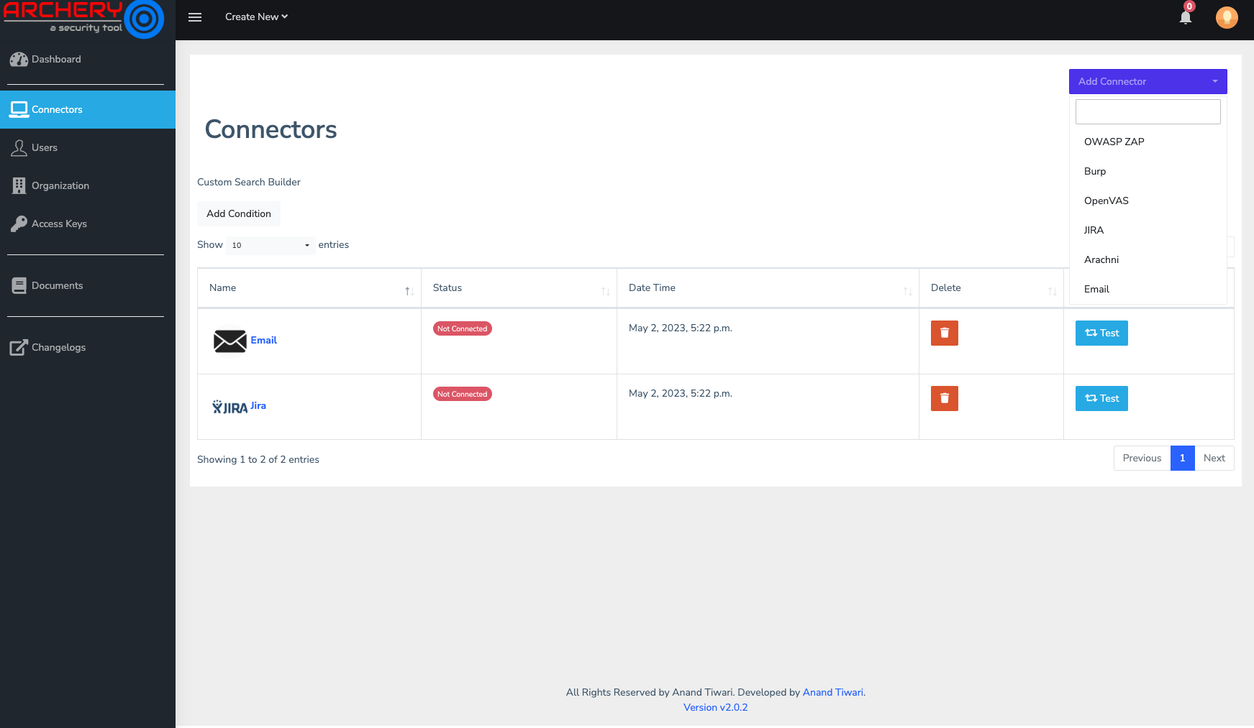

Slide 40
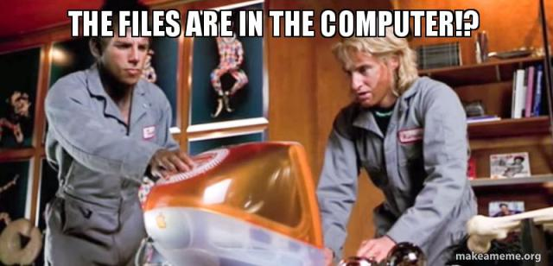
Pentesting
Burp Community Edition
Kali Linux
Metasploit
Researchers like you
Fiverr

Slide 41
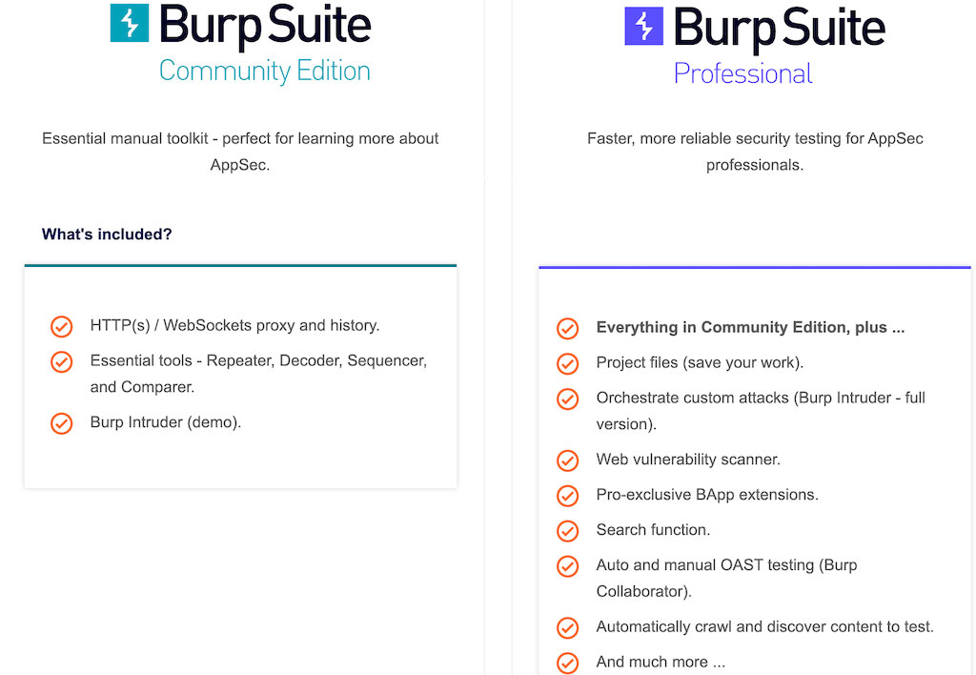
Notes:
https://portswigger.net/burp/communitydownload

Slide 42
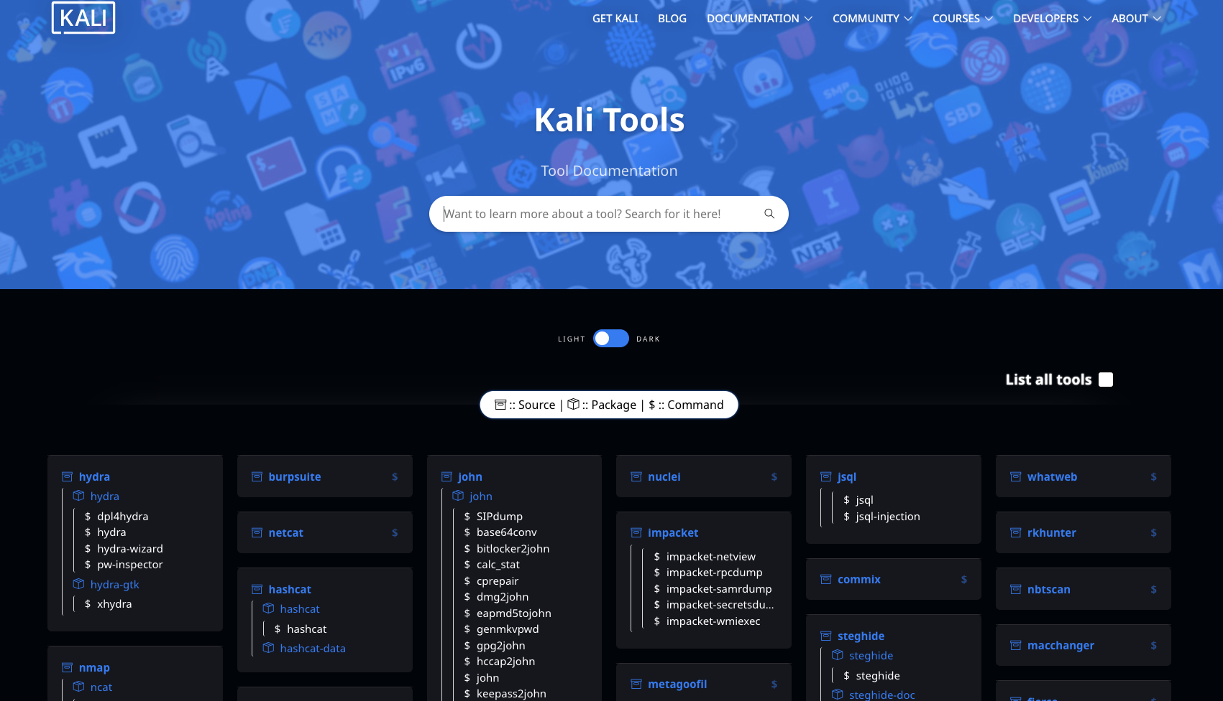
Notes:
https://www.kali.org/tools/

Slide 43
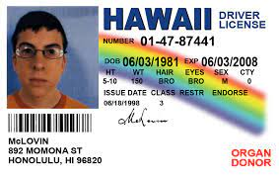
Licensing
Be careful
Limits on open source
Restrictions on types of users
Number of apps
Academia

Slide 44
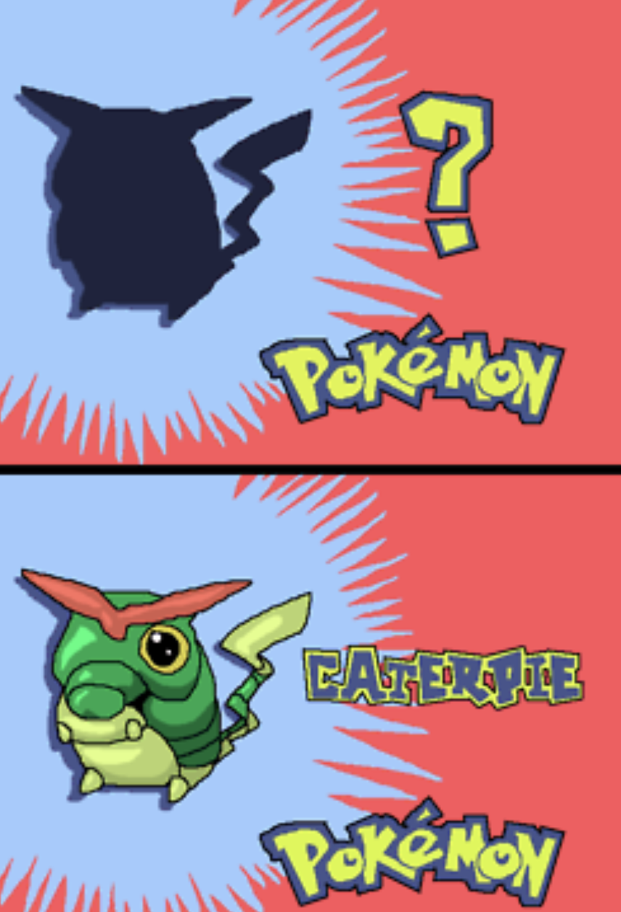
Training (Step 0)
YouTube
GitHub Curated Lists
PentesterLabs
HackTheBox
Codecademy
EverSec CTF
Doylersec’s Blog
Etc

Slide 45
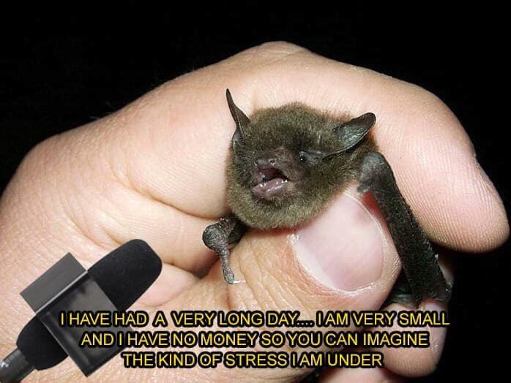
In Summary
Start free
Explore open-source
AppSec is for everyone

Slide 46
Qu3st10ns?

